Slide 1
Bayesian Belief Network
Solved Examples

Slide 2
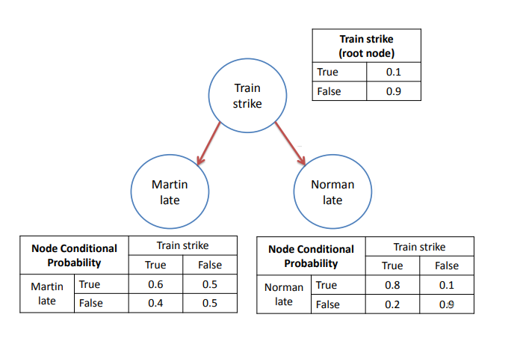
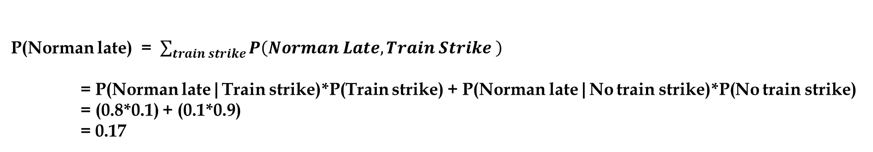
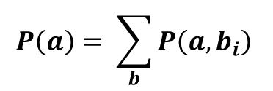
Marginal Probability Example
$$P\left(a\right)= \sum_{b}{P\left(a,b_{i}\right) }$$
Find P(Norman late) using the information given in Bayesian Belief Network
P(Norman late) = $\sum_{train strike}{P\left(Norman Late, Train Strike \right) }$
= P(Norman late|Train strike)*P(Train strike) + P(Norman late|No train strike)*P(No train strike)
= (0.8*0.1) + (0.1*0.9)
= 0.17

Slide 3
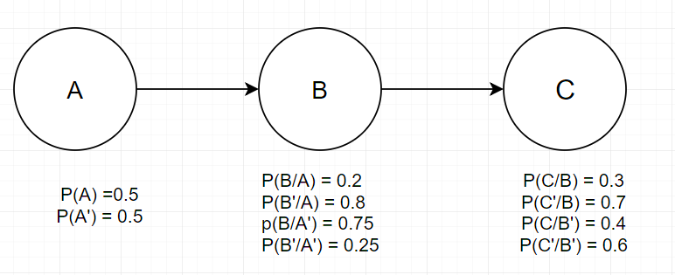
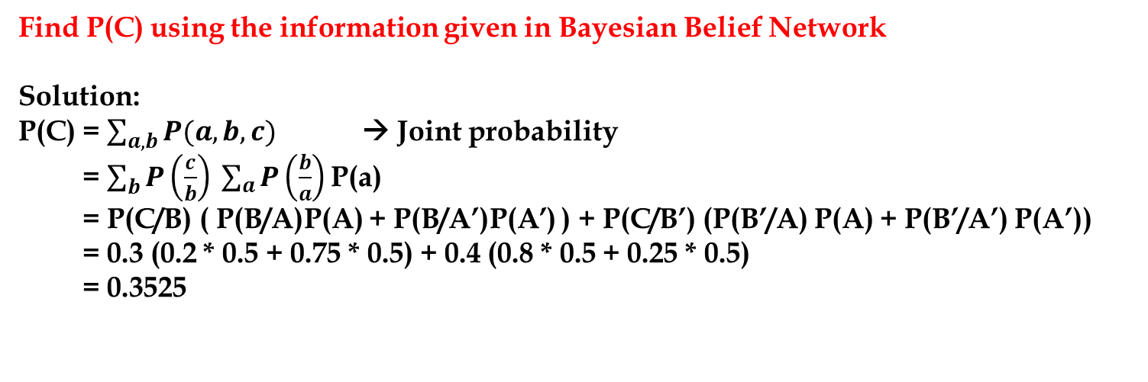
Chain Rule Example
Find P(C) using the information given in Bayesian Belief Network
Solution:
P(C) = $\sum_{a,b}{P(a,b,c)}$ → Joint probability
= $\sum_{b}{P\left(\frac{c}{b}\right) }\sum_{a}{P\left(\frac{b}{a}\right) }$P(a)
= P(C/B) ( P(B/A)P(A) + P(B/A’)P(A’) ) + P(C/B’) (P(B’/A) P(A) + P(B’/A’) P(A’))
= 0.3 (0.2 * 0.5 + 0.75 * 0.5) + 0.4 (0.8 * 0.5 + 0.25 * 0.5)
= 0.3525

Slide 4
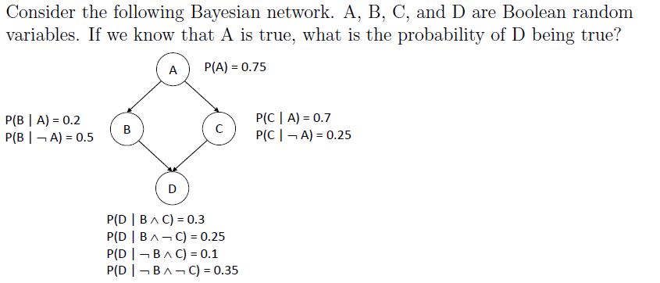

Slide 5
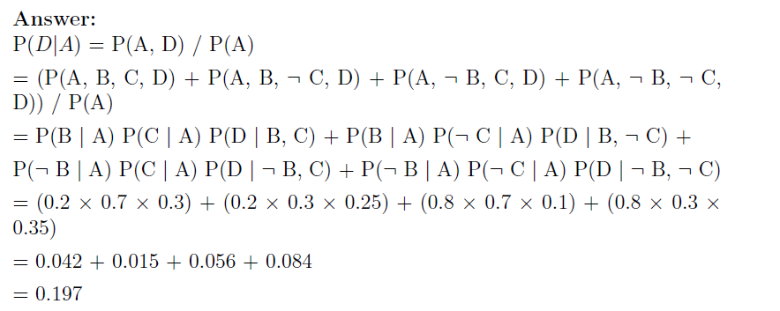

Slide 6
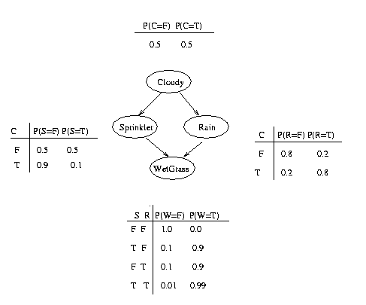
Which event is more likely -
Wetgrass due to sprinkler P(S=T,W=T) or
Wetgrass due to rain P(R=T, W=T)?

Slide 7
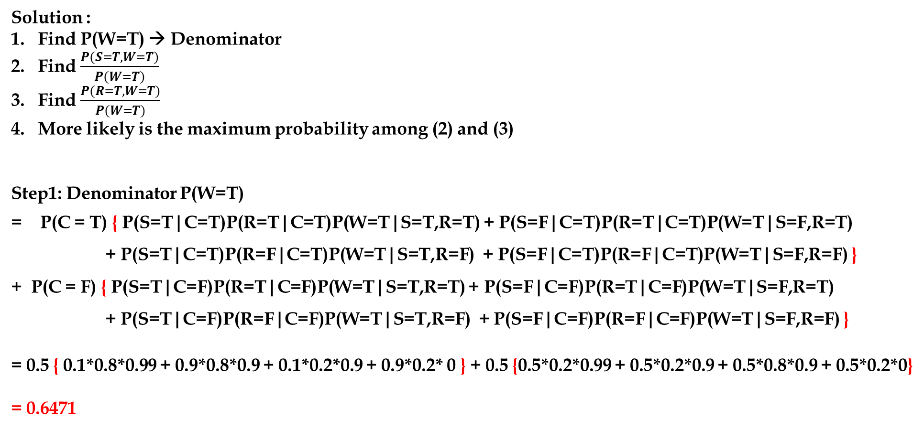
Solution :
Find P(W=T) → Denominator
Find $\frac{P(S=T,W=T)}{P(W=T)}$
Find $\frac{P(R=T,W=T)}{P(W=T)}$
More likely is the maximum probability among (2) and (3)
Step1: Denominator P(W=T)
= P(C = T) { P(S=T|C=T)P(R=T|C=T)P(W=T|S=T,R=T) + P(S=F|C=T)P(R=T|C=T)P(W=T|S=F,R=T)
+ P(S=T|C=T)P(R=F|C=T)P(W=T|S=T,R=F) + P(S=F|C=T)P(R=F|C=T)P(W=T|S=F,R=F) }
+ P(C = F) { P(S=T|C=F)P(R=T|C=F)P(W=T|S=T,R=T) + P(S=F|C=F)P(R=T|C=F)P(W=T|S=F,R=T)
+ P(S=T|C=F)P(R=F|C=F)P(W=T|S=T,R=F) + P(S=F|C=F)P(R=F|C=F)P(W=T|S=F,R=F) }
= 0.5 { 0.1*0.8*0.99 + 0.9*0.8*0.9 + 0.1*0.2*0.9 + 0.9*0.2* 0 } + 0.5 {0.5*0.2*0.99 + 0.5*0.2*0.9 + 0.5*0.8*0.9 + 0.5*0.2*0}
= 0.6471

Slide 8
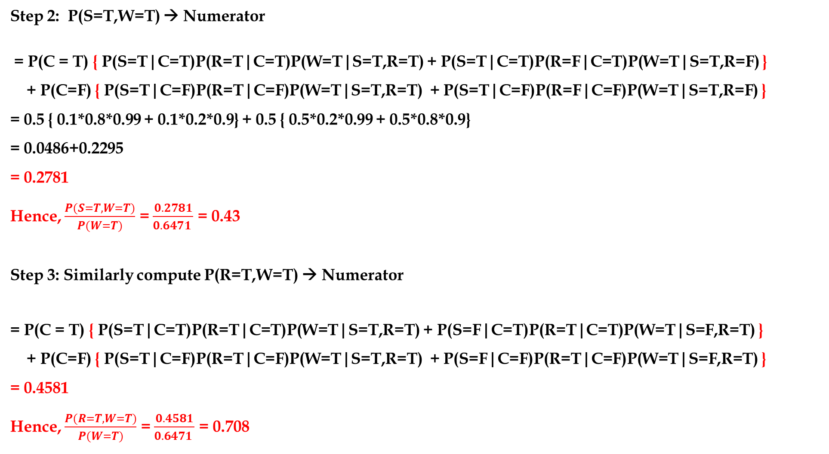
Step 2: P(S=T,W=T) → Numerator
= P(C = T) { P(S=T|C=T)P(R=T|C=T)P(W=T|S=T,R=T) + P(S=T|C=T)P(R=F|C=T)P(W=T|S=T,R=F) }
+ P(C=F) { P(S=T|C=F)P(R=T|C=F)P(W=T|S=T,R=T) + P(S=T|C=F)P(R=F|C=F)P(W=T|S=T,R=F) }
= 0.5 { 0.1*0.8*0.99 + 0.1*0.2*0.9} + 0.5 { 0.5*0.2*0.99 + 0.5*0.8*0.9}
= 0.0486+0.2295
= 0.2781
Hence, $\frac{P(S=T,W=T)}{P(W=T)}$ = $\frac{0.2781}{0.6471 }$ = 0.43
Step 3: Similarly compute P(R=T,W=T) → Numerator
= P(C = T) { P(S=T|C=T)P(R=T|C=T)P(W=T|S=T,R=T) + P(S=F|C=T)P(R=T|C=T)P(W=T|S=F,R=T) }
+ P(C=F) { P(S=T|C=F)P(R=T|C=F)P(W=T|S=T,R=T) + P(S=F|C=F)P(R=T|C=F)P(W=T|S=F,R=T) }
= 0.4581
Hence, $\frac{P(R=T,W=T)}{P(W=T)}$ = $\frac{0.4581}{0.6471 }$ = 0.708
It is more likely that grass is wet due to rain

